Slide 1
Investigating the relationship between Open Access, citations and altmetrics
Nicholas Fraser
CWTS, Leiden, Netherlands
7th February 2019

Slide 2
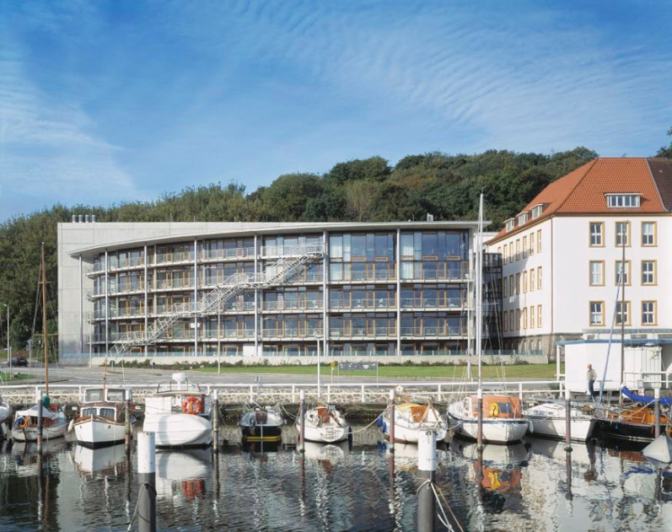
Who am I?
Academic background in Earth Science (PhD in paleoclimatology)
Then worked for 2.5 years at an academic publisher (Frontiers)
Now a postdoctoral researcher at ZBW Kiel, Germany

Slide 3

“Open AccesS Effects”
Joint project between GESIS (Philipp Mayr, Fakhri Momeni) and ZBW (Isabella Peters, Nicholas Fraser).
Broad aim is to investigate factors influencing the impact of OA publications:
Structural factors (OA mandates, publishing models)
Authorship factors (demographics, selectivity)

Slide 4
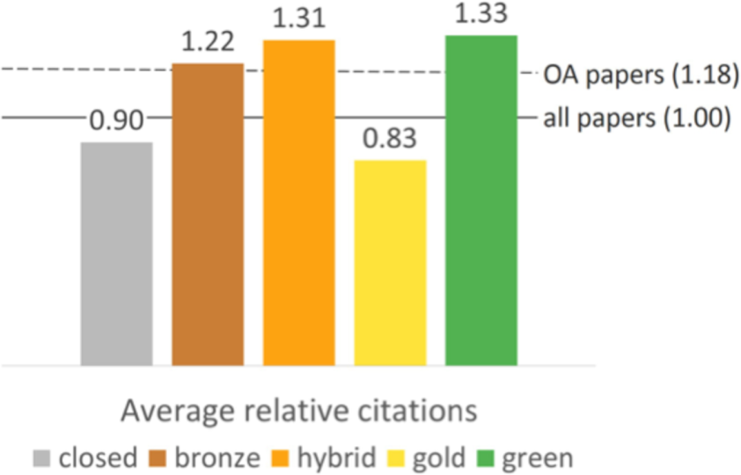
The OA citation advantage
Plan S: “There is no valid reason to maintain any kind of subscription-based business model for scientific publishing in the digital world, where Open Access dissemination is maximising the impact, visibility, and efficiency of the whole research process¹ ”.
OA articles are generally cited more than non-OA articles (“OA citation advantage”).
Citation rates differ by the route to OA: articles published via the Gold route tend to receive less citations than via Green/Hybrid routes.
Piwowar et al. (2018): https://doi.org/10.7717/peerj.4375
¹ https://coalition-s.org/why-plan-s/
Notes:
Why does it matter?
Uncertainty for authors: why should I publish my article in an OA journal/institutional repository?
Policy makers

Slide 5
The OA citation advantage
Why are OA publications cited more than non-OA publication?
Open Access effect
A paper is open, therefore it is easier to download, read, and to cite
The rich get richer
Early Access effect
Earlier availability (via self-archiving) leads to a (short-term) boost in citation rates
Quality effect
Higher quality papers are overrepresented amongst OA papers
Authors self-select their highest quality papers to make OA

Slide 6
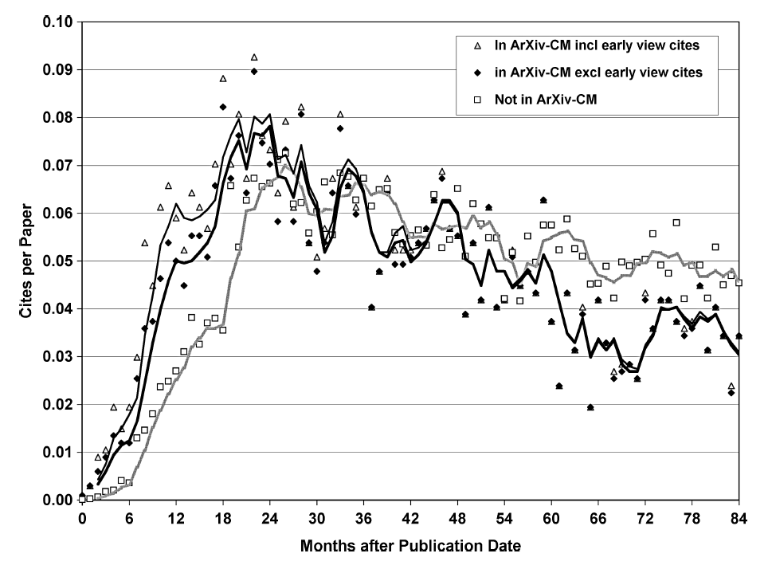
The Early Access effect
Journal articles that were previously deposited to arXiv were cited more quickly following journal publication than articles not deposited (e.g. Davis and Fromerth, 2007, Moed, 2007; Gentil-Beccot et al., 2010; Larivière et al., 2014).
Moed (2007): https://arxiv.org/abs/cs/0611060
Notes:
arXiv-CM = Condensed Matter

Slide 7

Rise of the preprints
https://osf.io/preprints/

Slide 8

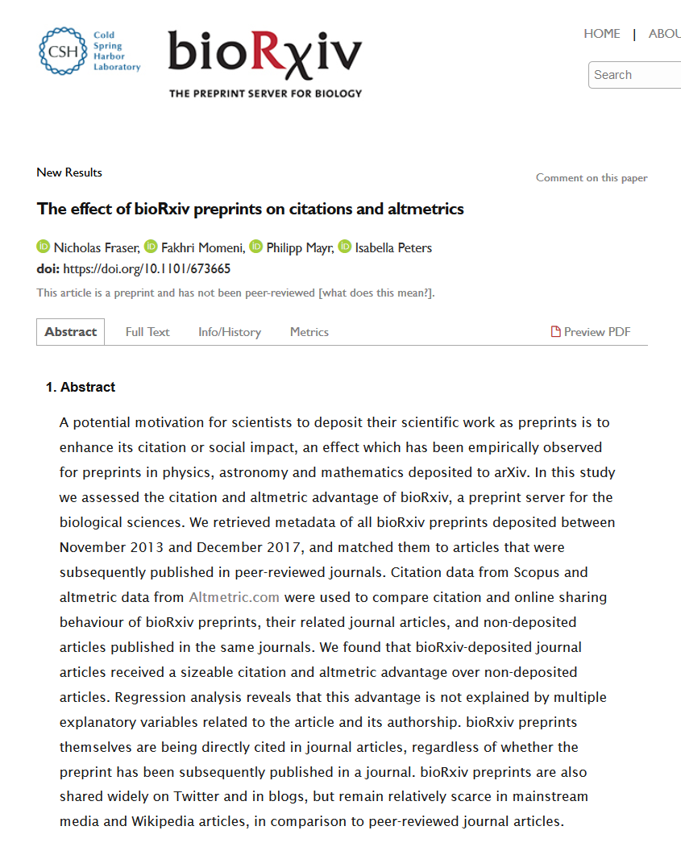
The Early Access effect in
Do the findings from arXiv apply to other subject areas?
Can we say something about the mechanism driving differences in citation behaviour between articles with and without preprints?
What about other metrics of impact, e.g. altmetrics?
https://doi.org/10.1101/673665

Slide 9
Data retrieval
Retrieve preprint metadata (N ~18,000)
(Crossref)
Match preprints to journal articles (N ~ 7000)
(Crossref, bioRxiv website*, Scopus)
Month and journal-matched control group
(N ~ 7000) (Scopus)
Citation counts, monthly aggregated (Scopus, Crossref)
Altmetric counts (Altmetric.com)
*See R package: https://github.com/nicholasmfraser/biorrxiv
Notes:
Study period limited from 2013 to 2017

Slide 10
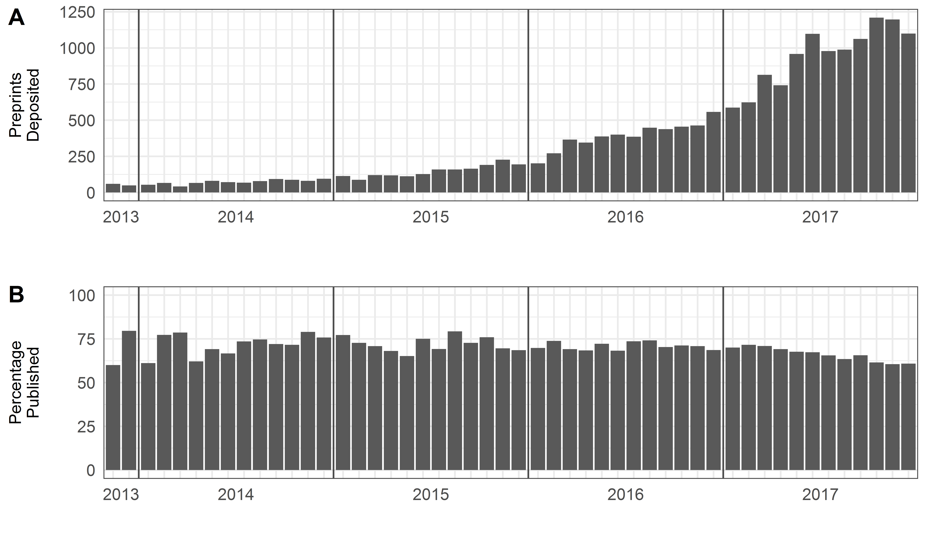
Development of bioRxiv

Slide 11
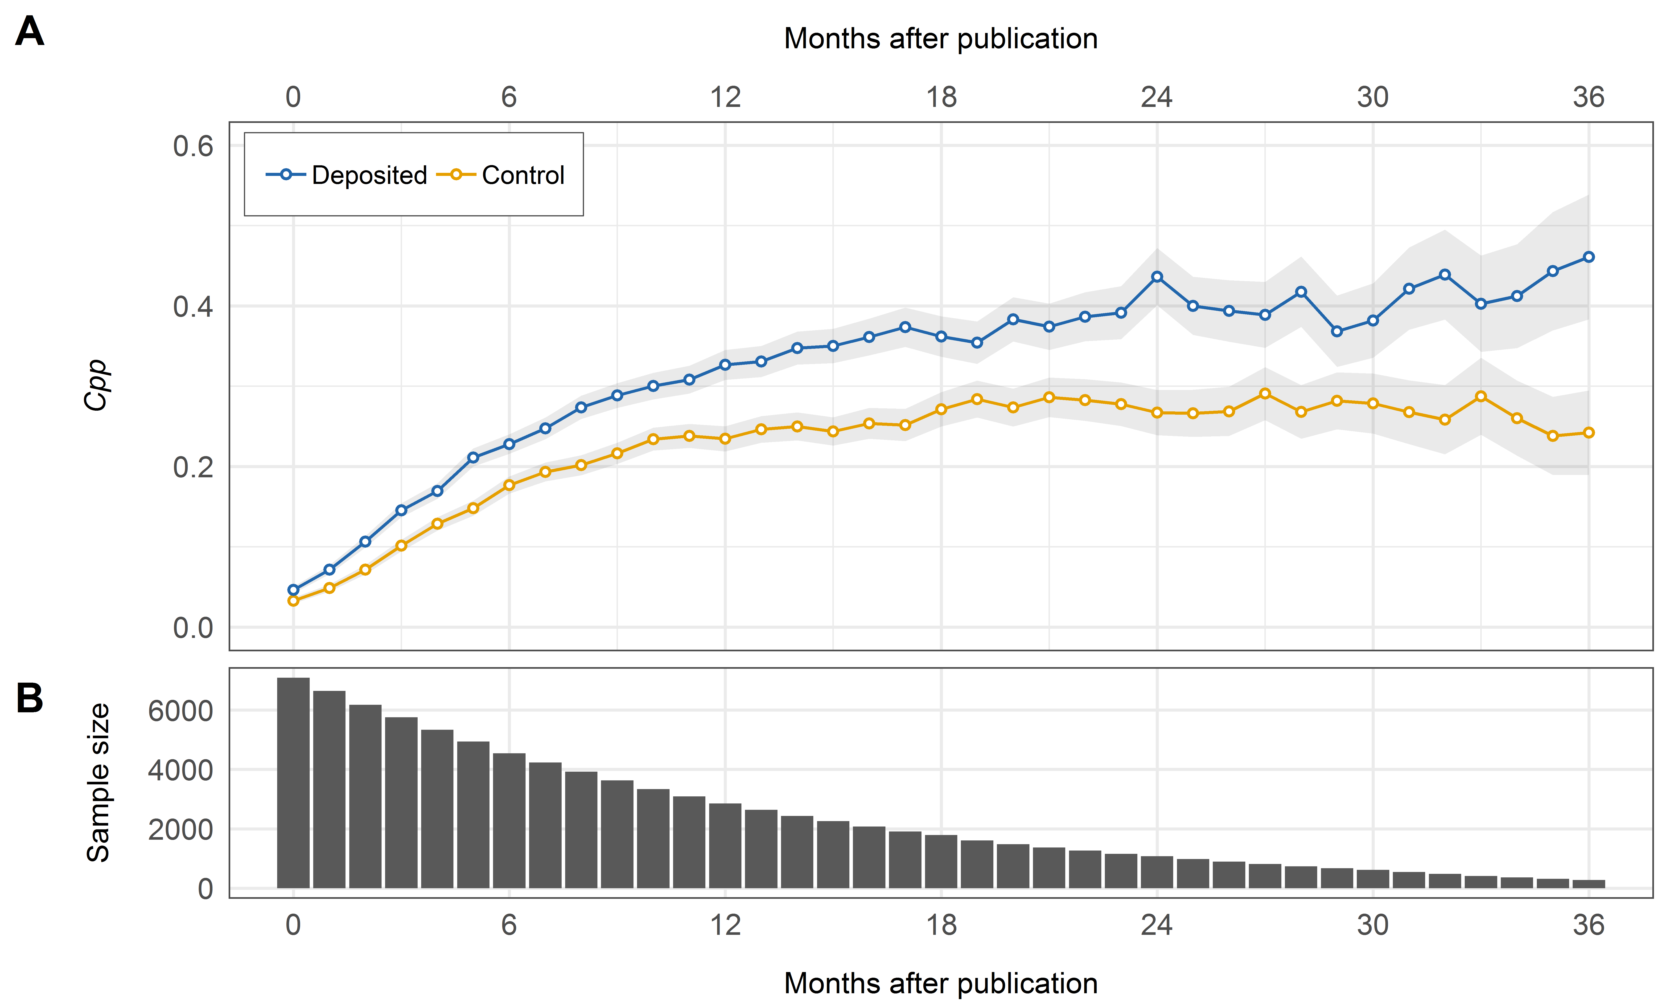
Is there an Early Access effect in bioRxiv?
Cpp = ∑(log(Citations+1) / N

Slide 12
What about altmetrics?

Slide 13
Are citations/altmetrics driven by author/article characteristics?
Characteristic | Variable | bioRxiv-deposited | Control
Journal Impact Factor | Median Journal Impact Factor | 4.53 | 4.53
OA article | % papers that are OA | 88.1 | 83.5
Review article | % review articles | 2.79 | 5.32
Author count | Median author count per article | 5 | 6
First author from USA | % US first authors | 49.3 | 37.4
Last author from USA | % US last authors | 49.5 | 37.6
First author academic age | Median first author academic age (years) | 5 | 5
Last author academic age | Median last author academic age (years) | 17 | 19
First author gender | % articles with female first authors | 29.9 | 36.0
Last author gender | % articles with female last authors | 18.0 | 23.9
Regression analysis shows that when controlling for these characteristics, preprint deposition remains a strong predictor of future citations.

Slide 14
Summary?
Text

Slide 15
Open Access and Altmetrics
ElSabry (2017): “There is strong support of the idea that Open Access has benefits to different groups of people outside the university/credentialed research institutes. It is not clear how much evidence is available to support these claims, but identifying them would suggest new stakeholders to involve in the conversation and perhaps also inform the ongoing debate about who should bear the cost of Open Access¹.”
Can altmetrics provide some evidence to support these claims?
¹ https://doi.org/10.3233/978-1-61499-769-6-34

Slide 16
Open Access and Altmetrics: Previous Work
Holmberg et al. (2019) studied frequency of mentions to OA articles versus non-OA articles in . „The results show significant disciplinary and platform specific differences in the OA advantage”

Slide 17
Research Questions
RQ1: Do OA articles receive more/different altmetric attention than non-OA articles?
RQ2: Do articles with different types of OA differ in the altmetric attention they receive?
RQ3: Which additional factors influence the relationship between OA and altmetrics*?
RQ4: What are the limitations with current data sources in measuring the large-scale relationship between OA and altmetrics?
* e.g. time, document types, disciplines, authorship countries, journal prestige

Slide 18
Methods
Article corpus: Web of Science, 2012-2018, Article and Review type documents (CWTS database)
OA classification
OA classification

Slide 19
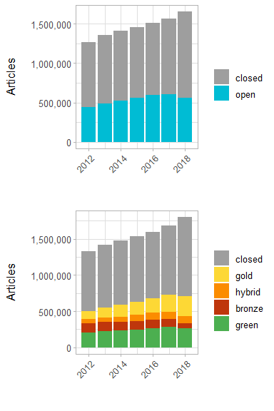
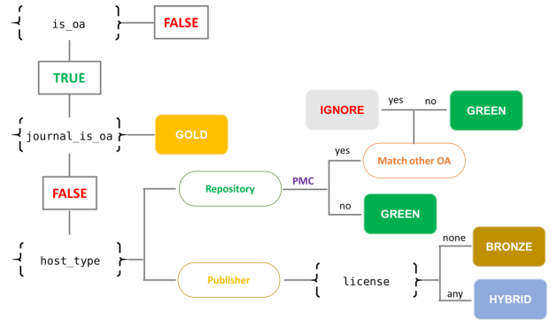
Open Access Classification
Followed the classification scheme of Robinson-Garcia et al. (2019), based on data from Unpaywall:

Slide 20
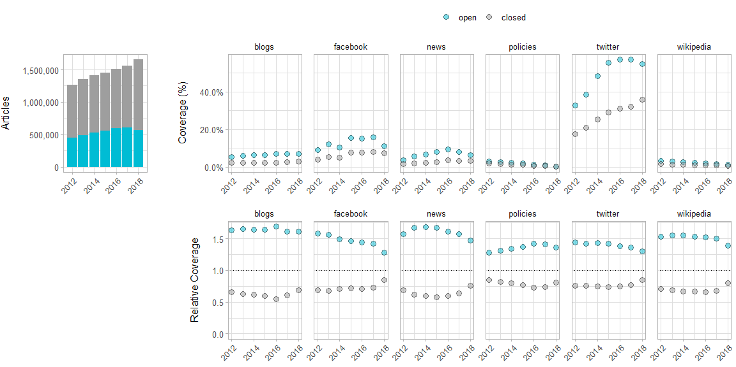
RQ1: Do OA articles receive more/different altmetric attention than non-OA articles?

Slide 21
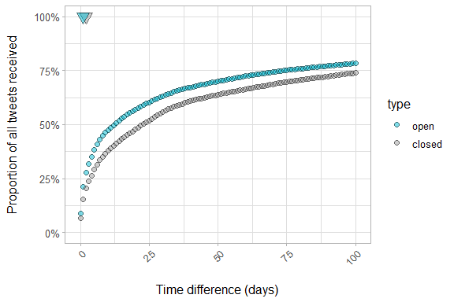
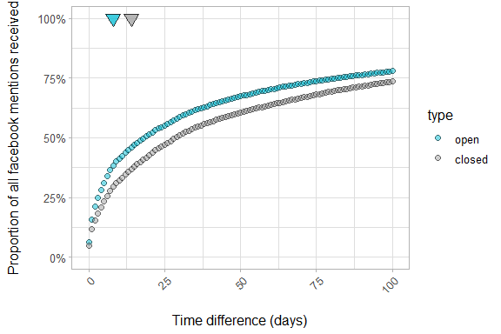
RQ1: Do OA articles receive more/different altmetric attention than non-OA articles?
Twitter
Facebook

Slide 22
RQ1: Do OA articles receive more/different altmetric attention than non-OA articles?
Twitter
Facebook

Slide 23
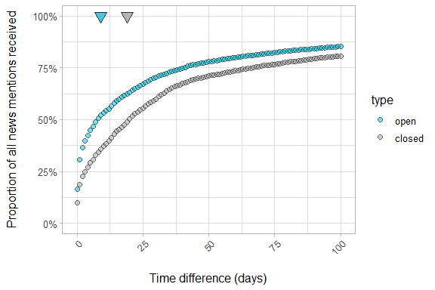
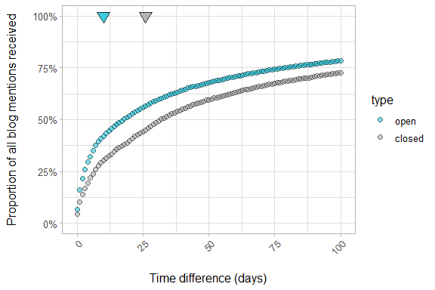
RQ1: Do OA articles receive more/different altmetric attention than non-OA articles?
News
Blogs

Slide 24
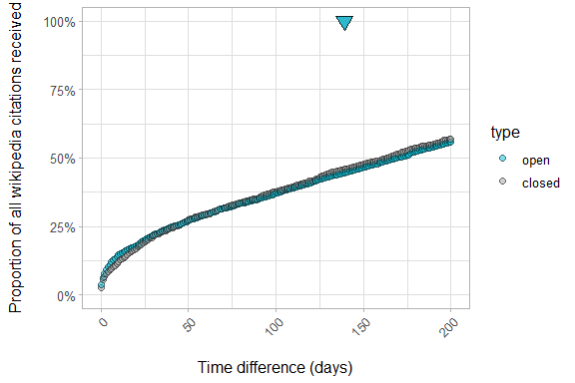
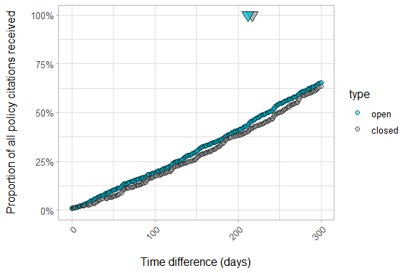
RQ1: Do OA articles receive more/different altmetric attention than non-OA articles?
Wikipedia
Policies

Slide 25
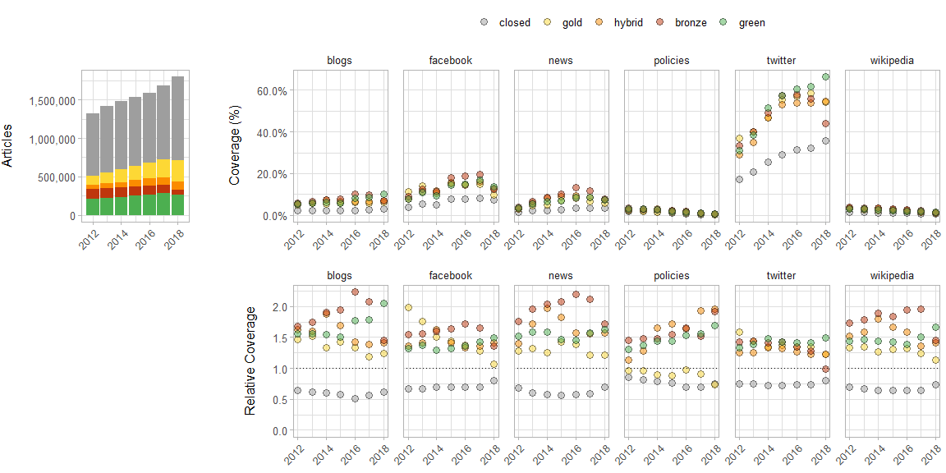
RQ2: Do articles with different types of OA differ in the altmetric attention they receive?

Slide 26
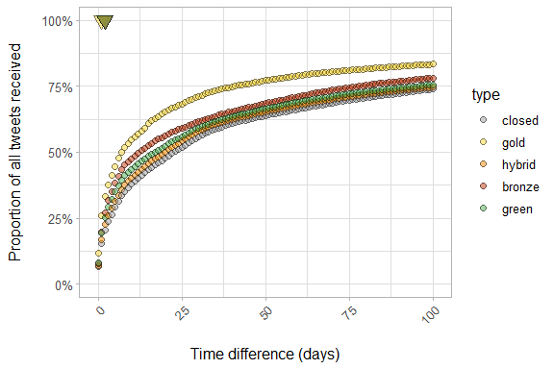
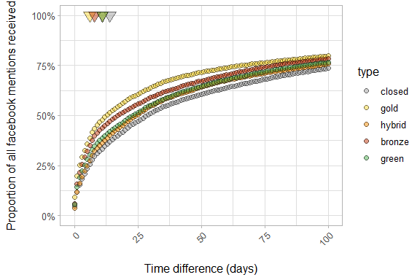
RQ2: Do articles with different types of OA differ in the altmetric attention they receive?
Twitter
Facebook

Slide 27
RQ2: Do articles with different types of OA differ in the altmetric attention they receive?
Twitter
Facebook

Slide 28
RQ2: Do articles with different types of OA differ in the altmetric attention they receive?
Twitter
Facebook

Slide 29
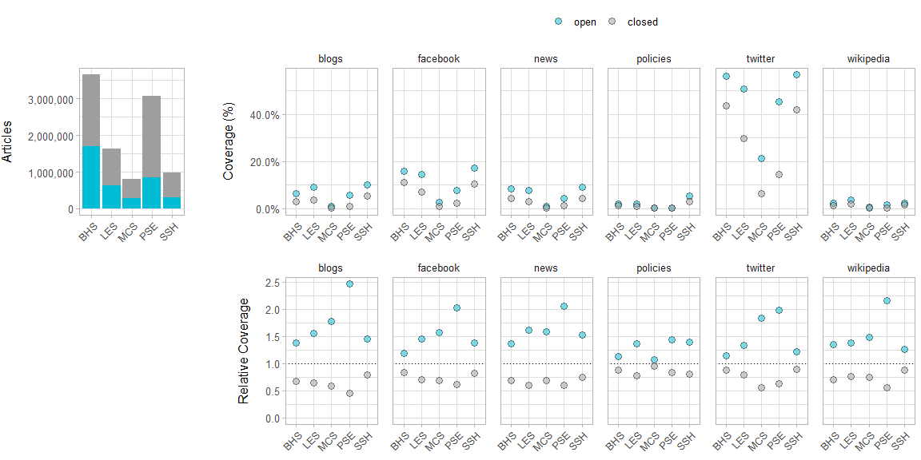
RQ3: Which additional factors influence the relationship between OA and altmetrics?

Slide 30
Title
Text

Slide 31
Title
Text

Slide 32
RQ4: What are the limitations in measuring the large-scale relationship between OA and altmetrics?
Units of analysis (discipline/countries/document types) cannot be considered in isolation – there is likely interaction between each unit.
Data presented here are purely observational – no proof of causality.
Significant barriers with respect to coverage and content of data sources themselves, which may introduce systematic bias into analyses.

Slide 33
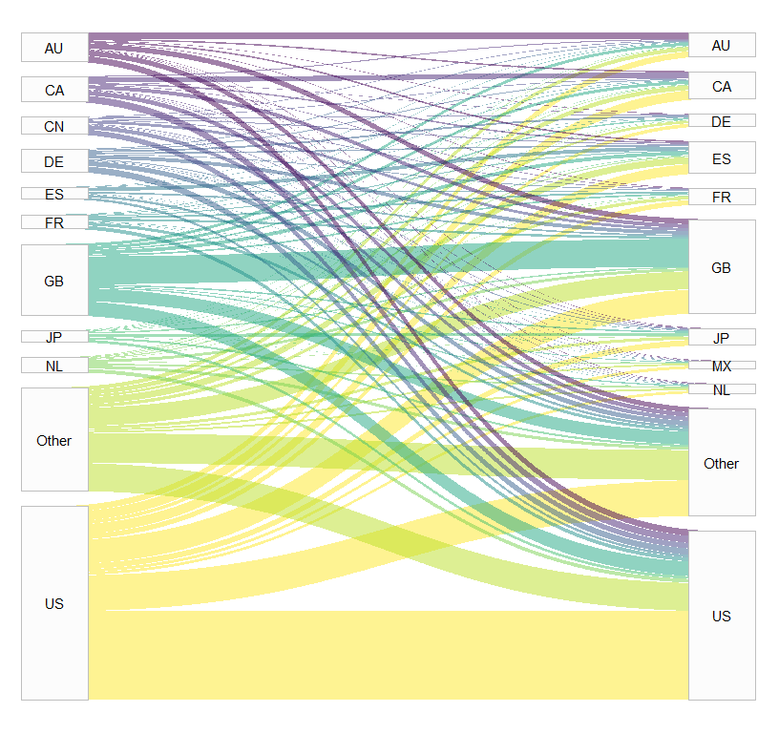
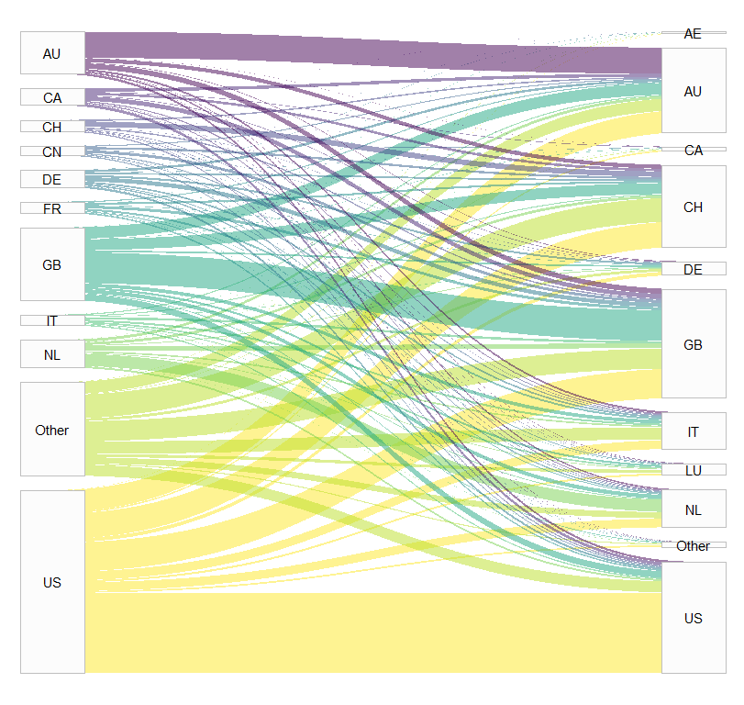
RQ4: What are the limitations in measuring the large-scale relationship between OA and altmetrics?
Countries of tweeted papers
Countries of tweeters
Countries of papers cited in policies
Source country of policies

Slide 34
Summary

Slide 35
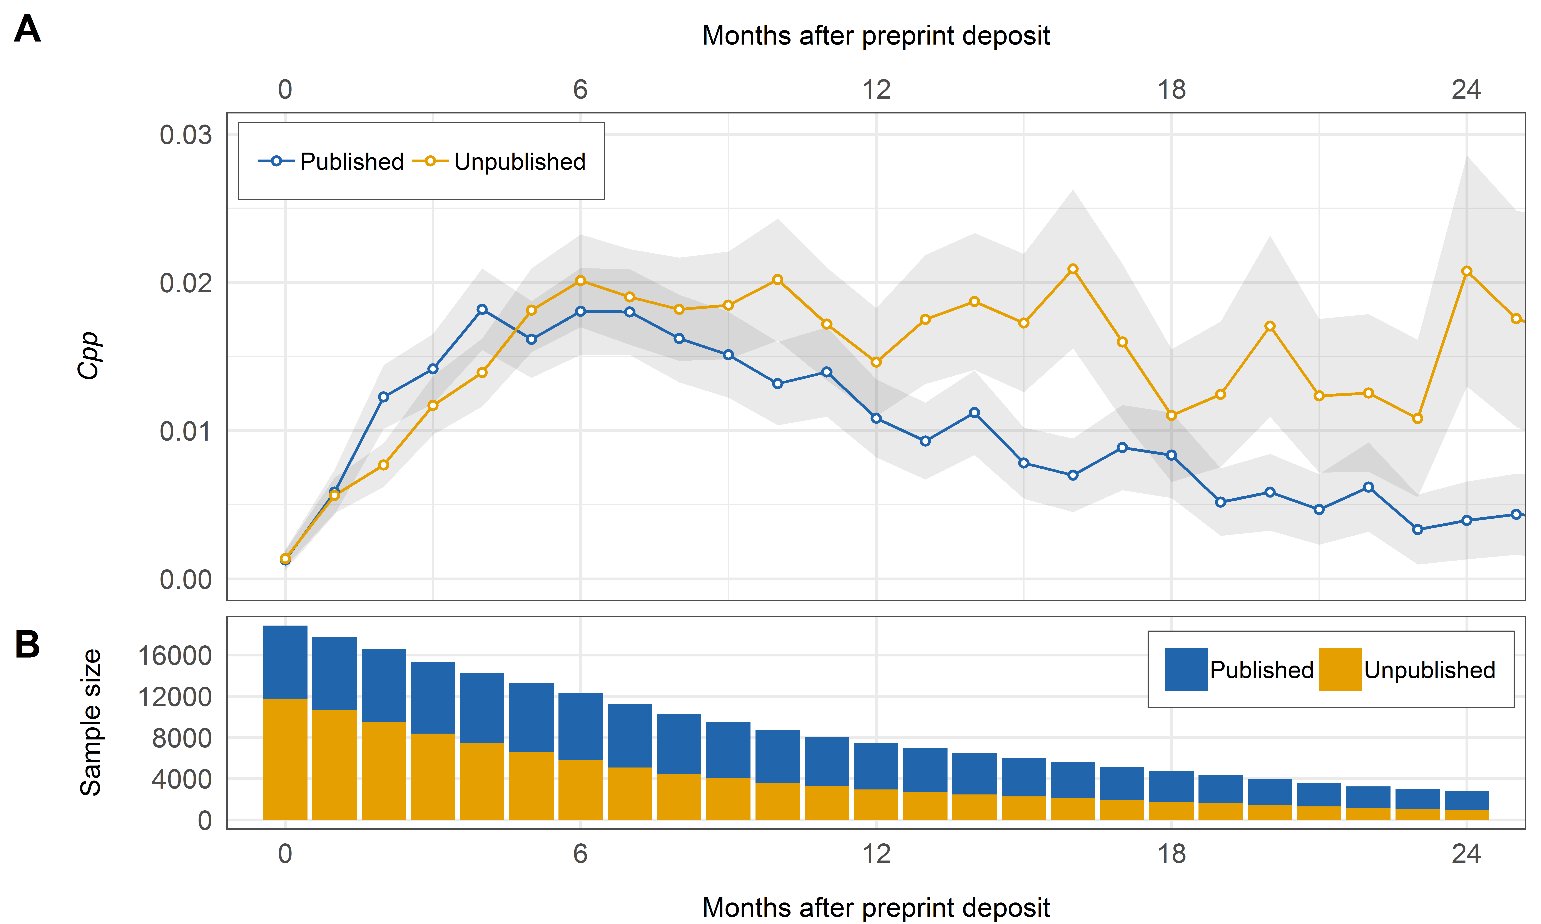
Direct citations to published and unpublished preprints

Slide 36
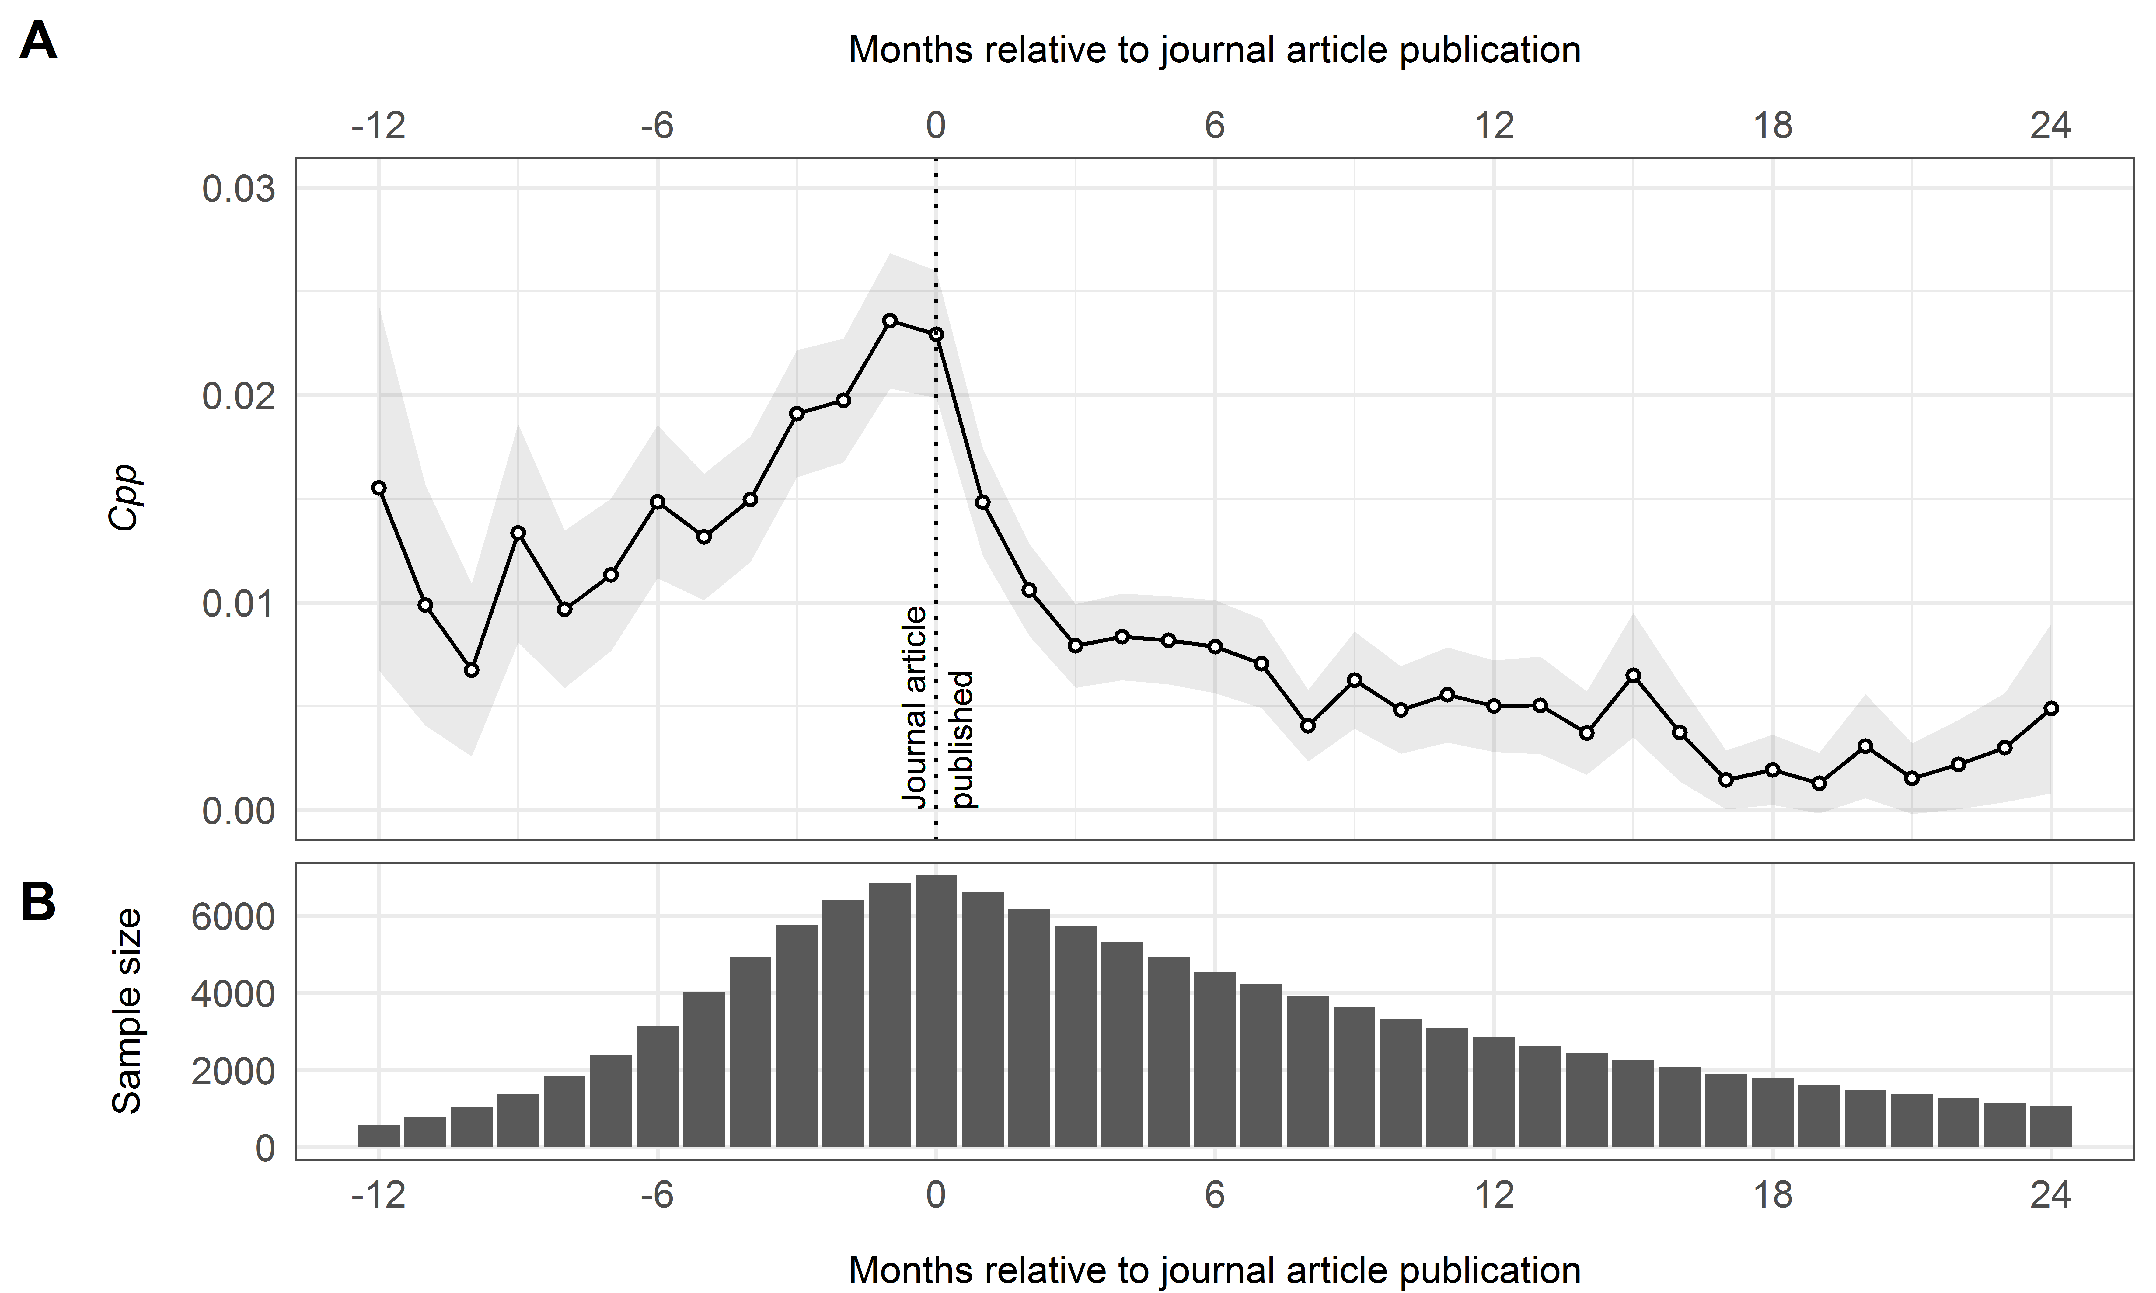
Direct citations to preprints following journal publication

